Slide 1


Keeping Our Friends Safe
Part 2
Notes:
ADOBE STOCK
Certain photographs used in this report have been licensed from Adobe Stock.
These photographs are protected by copyright law. Resale or use of any photos used in this report is prohibited.
Photographs © / Adobe Stock

Slide 2


Consider the scenarios on the next few slides:

Slide 3
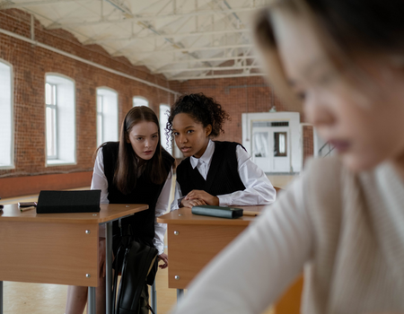
Scenario 1
Every day, Lucy and Daisy make nasty comments about Ling under their breath in class. Fay sees this and asks them to stop. They don’t. What could Fay do?
Notes:
ADOBE STOCK
Certain photographs used in this report have been licensed from Adobe Stock.
These photographs are protected by copyright law. Resale or use of any photos used in this report is prohibited.
Photographs © / Adobe Stock

Slide 4
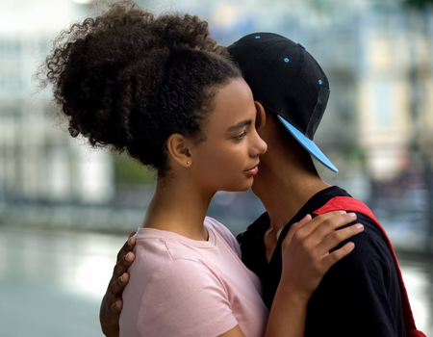
Scenario 2
Jayden has been going out with Kia for three months. They have a laugh together but Jayden keeps asking Kia to send him nude pictures. Kia tells Ellie about this and asks her not to tell anyone. What could Ellie do?
Notes:
ADOBE STOCK
Certain photographs used in this report have been licensed from Adobe Stock.
These photographs are protected by copyright law. Resale or use of any photos used in this report is prohibited.
Photographs © / Adobe Stock

Slide 5
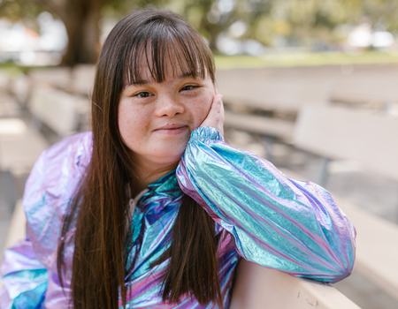
Scenario 3
Vicki tells Charlotte that her brother’s friend keeps bringing her presents when he visits their house. Last time he came round they had a quick kiss when her brother went to the toilet. Vicki is flattered as he is 21 and she didn’t think he’d be interested in a girl her age. What should Charlotte do?
Notes:
ADOBE STOCK
Certain photographs used in this report have been licensed from Adobe Stock.
These photographs are protected by copyright law. Resale or use of any photos used in this report is prohibited.
Photographs © / Adobe Stock

Slide 6
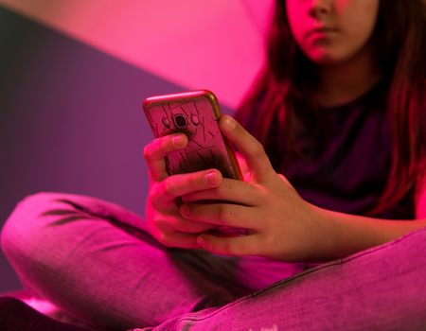
Scenario 4
Isla is talking to an online friend that she hasn’t met in person. The online friend tells Isla that they’ve started to have feelings for her and they should be boyfriend and girlfriend. Isla says she has feelings for them too and they arrange to meet up alone. Isla is excited and tells her friend Lauren. What could Lauren do?
Notes:
ADOBE STOCK
Certain photographs used in this report have been licensed from Adobe Stock.
These photographs are protected by copyright law. Resale or use of any photos used in this report is prohibited.
Photographs © / Adobe Stock

Slide 7
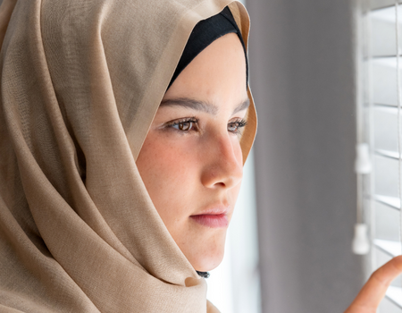
Scenario 5
Olivia is worried about her friend Asha. Asha says that she is really anxious about the exams coming up and is thinking of hurting herself. Olivia doesn’t know what to do as Asha hasn’t actually hurt herself and has asked Olivia to not tell anyone. What could Olivia do?
Notes:
ADOBE STOCK
Certain photographs used in this report have been licensed from Adobe Stock.
These photographs are protected by copyright law. Resale or use of any photos used in this report is prohibited.
Photographs © / Adobe Stock

Slide 8
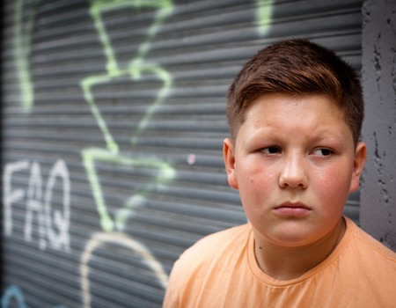
Scenario 6
Max is friends with Chris and has been round his house a few times. Last time he was there Chris’ dad had a real go at him for forgetting to put the bins out and slapped Chris round the face. Chris has told Max that it happens quite a lot and that his dad smashed his phone up when he failed his latest maths test. What could Max do?
Notes:
ADOBE STOCK
Certain photographs used in this report have been licensed from Adobe Stock.
These photographs are protected by copyright law. Resale or use of any photos used in this report is prohibited.
Photographs © / Adobe Stock

Slide 9
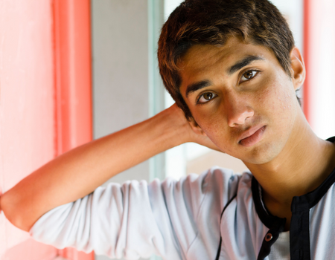
Scenario 7
Tom notices that Aran is talking about going out to parties every weekend. Aran tells Tom that the older guys bring along loads of alcohol and they all get wasted. A few times Aran has got so drunk that he can’t remember what happened and has had to miss football the next day. What could Tom do?
Notes:
ADOBE STOCK
Certain photographs used in this report have been licensed from Adobe Stock.
These photographs are protected by copyright law. Resale or use of any photos used in this report is prohibited.
Photographs © / Adobe Stock

Slide 10
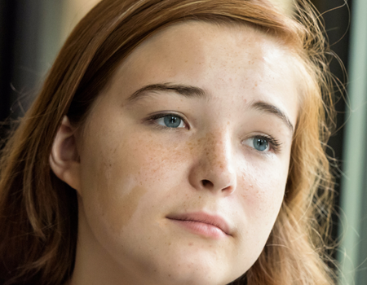
Scenario 8
Lily notices that Sophie is talking a lot about her clothes and how she looks. She also sees that Sophie is leaving most of her lunch. This happens a few times and Lily doesn’t know what to do. What could Lily do?
Notes:
ADOBE STOCK
Certain photographs used in this report have been licensed from Adobe Stock.
These photographs are protected by copyright law. Resale or use of any photos used in this report is prohibited.
Photographs © / Adobe Stock

