Slide 1


Keeping Our Friends Safe
Part 1
Notes:
ADOBE STOCK
Certain photographs used in this report have been licensed from Adobe Stock.
These photographs are protected by copyright law. Resale or use of any photos used in this report is prohibited.
Photographs © / Adobe Stock

Slide 2
Who might our friends be?

Slide 3
Who might our friends be?
People where we live
People in school
People online
People in our family
People we go to clubs with

Slide 4
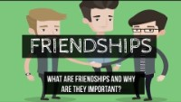
What are friendships?
Notes:
Discuss fun, laughter, sharing ideas, sharing thoughts etc. Play clip.

Slide 5

What do our friends do for us?
Friends can help you celebrate good times and provide support during bad times. Friends prevent isolation and loneliness and provide companionship.
Notes:
Friends can also:
Increase your sense of belonging and purpose.
Boost your happiness and reduce your stress.
Improve your self-confidence and self-worth.
Help you cope with traumas, such as divorce, serious illness, job loss or the death of a loved one.
Encourage you to change or avoid unhealthy lifestyle habits, such as excessive drinking or lack of exercise.

Slide 6

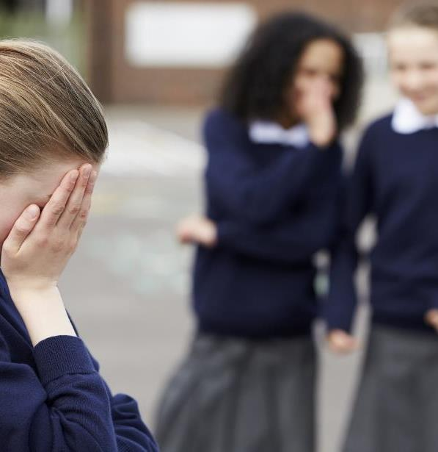
Friends sometimes share secrets.
When can secrets be good? Can they be bad?
Notes:
Discuss.

Slide 7

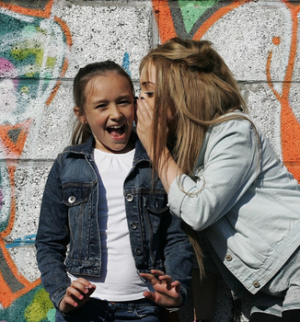



Secrets can be great!
Notes:
Share experiences.

Slide 8


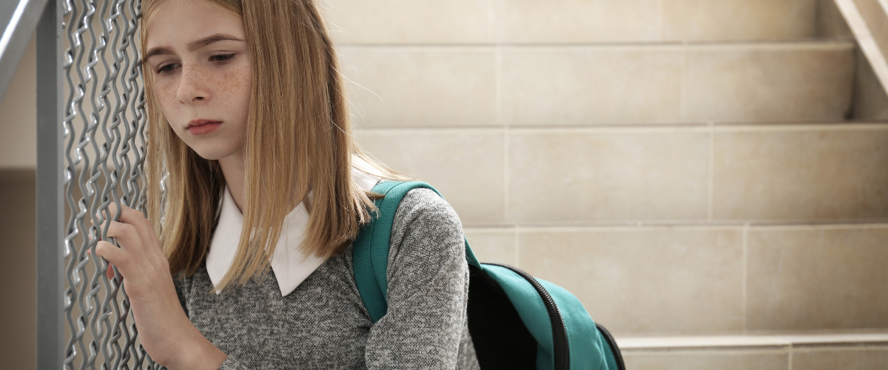
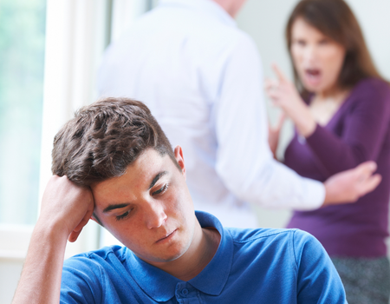
Some secrets need to be shared. But who with?
Notes:
Discuss thoughts/Ideas. Who can they trust? Who could they tell if something was bothering them?

Slide 9
Who should we share things with if we are worried?
Someone we trust
A responsible adult at home
A responsible adult at school
Another responsible adult

Slide 10

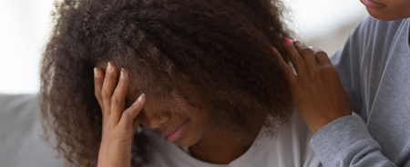
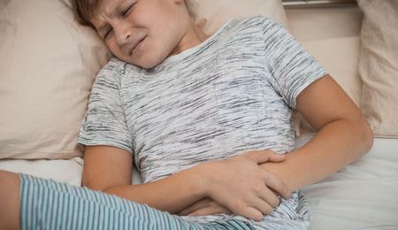
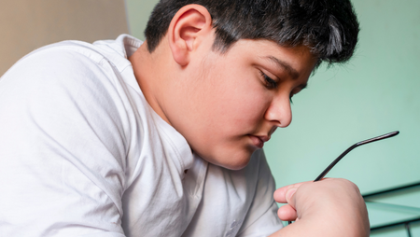

How do you know that it’s a bad secret?
Notes:
Discuss how you feel when you know something isn’t right. Tummy feelings, trouble sleeping, lack of appetite.

Slide 11
Remember:
Being a good friend means helping to keep your friends safe. Sometimes you need to ask an adult to help you.

Slide 12
Who else can help?
Childline:
https://www.childline.org.uk/info-advice/friends-relationships-sex/friends/helping-friend/
NSPCC:
https://www.nspcc.org.uk/preventing-abuse/keeping-children-safe/

