Slide 1

Keeping Our Friends Safe
Part 2
Notes:
ADOBE STOCK
Certain photographs used in this report have been licensed from Adobe Stock.
These photographs are protected by copyright law. Resale or use of any photos used in this report is prohibited.
Photographs © / Adobe Stock

Slide 2
Who might our friends be?

Slide 3
Who might our friends be?
People where we live
People in school
People online
People in our family
People we go to clubs with

Slide 4
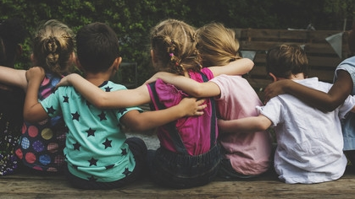
What should we do if a friend is in trouble?

Slide 5
Who should we get help from?
Someone we trust
A responsible adult at home
A responsible adult at school
Another responsible adult

Slide 6
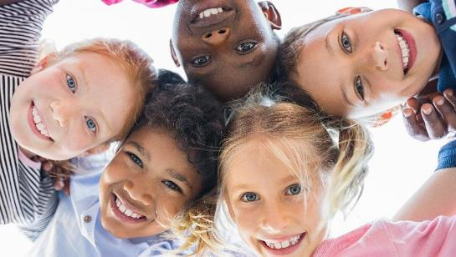
Consider the scenarios on the next few slides.

Slide 7
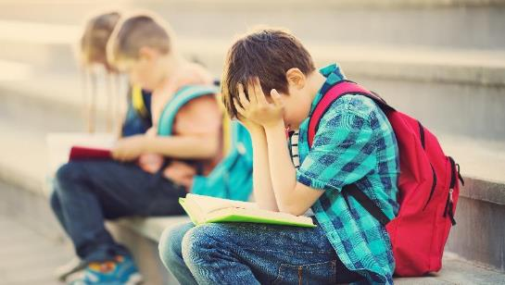
Scenario 1
Every day Emilio moves Freddie’s bag from his peg, and he regularly trips him up on the football pitch. Max sees this and asks Emilio to stop. He doesn’t. What could Max do?

Slide 8
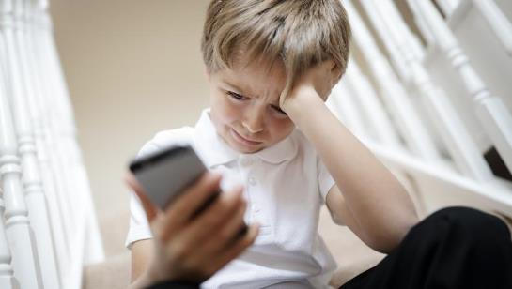
Scenario 2
George finds a picture on the internet that is for grown ups and sends it to Harry. Harry knows it isn’t for children, but doesn’t want to get George in trouble. What could Harry do?

Slide 9
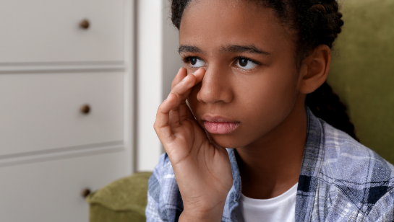
Scenario 3
Rasida tells Charlotte that her dad’s friend makes her feel uncomfortable when he cuddles her and she doesn’t like him doing this. Charlotte doesn’t like hearing this and worries about Rasida. What could Charlotte do?

Slide 10
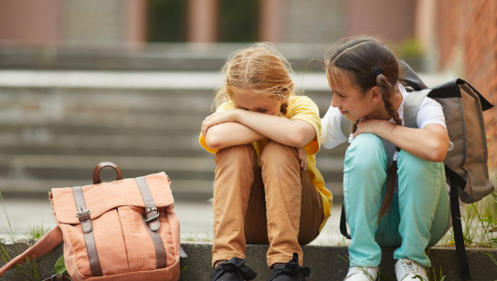
Scenario 4
Jess is talking to an online friend that she hasn’t met in person. The online friend asks Jess to send them a picture of her looking pretty. Jess sends the picture. Then Jess worries it wasn’t the right things to do and tells her friend Zaria. What could Zaria do?

Slide 11
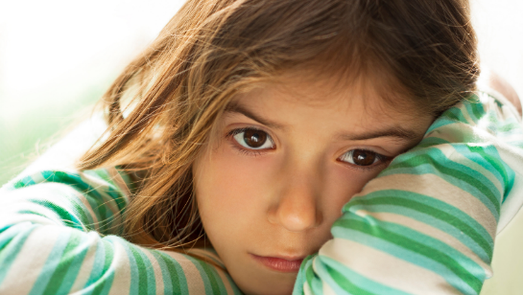
Scenario 5
Amelia is worried about her friend Rebecca. Rebecca says that she is hurting herself at home. Amelia doesn’t understand what this means, but it makes her feel a bit scared. What could Amelia do?

Slide 12
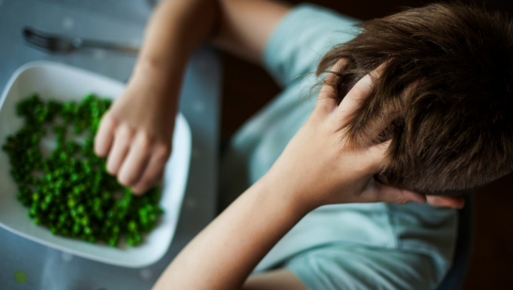
Scenario 6
James notices that Noah is talking a lot about his clothes and how he looks. He also sees that Noah is leaving most of his lunch. This happens a few times and James doesn’t know what to do. What could James do?

Slide 13

Scenario 7
Ru is friends with Leo online. They have been gaming for over a year so they know each other well. Leo says that Ru is his best friend and he wants to meet him. Leo says it would be best if they do it without anyone else around. Ru tells his friend Ethan about Leo and says they’re going to meet up. What could Ethan do?

Slide 14
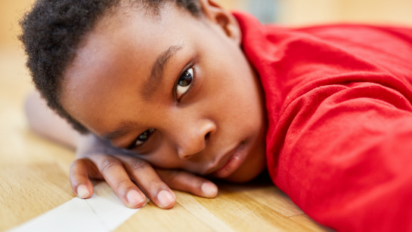
Scenario 8
Ben is worried about his friend Jamal. Jamal doesn’t seem happy and he keeps saying he ‘hates’ groups of people, like some of the children that live in the caravans down the road. He seems really angry. What could Ben do?

Slide 15
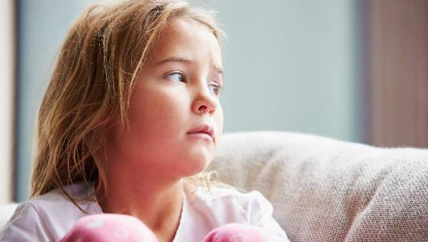
Scenario 9
Jess is in the same class as Matthew and they have always been friends. Matthew starts texting Jess messages that are confusing, saying that he doesn’t think she is very nice. Matthew says that Jess is ugly and annoying. Jess asks him to stop, but he doesn’t. Jess tells Navi. What could Navi do?

Slide 16
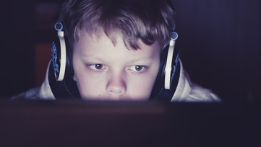
Scenario 10
Oliver has been talking to Will about watching things on YouTube and about joining a group who might be able to change the world. He says he's spoken to someone who wants him to help. Will isn't sure about this and feels a bit scared. What could Will do?

Slide 17
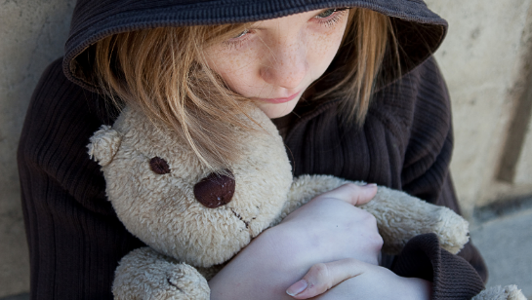
Scenario 11
Suki tells Lucy that her step brother is ‘being weird and wrestling with her’. She also says that he walked in on her in the bathroom and she didn’t like it. What could Lucy do?

Slide 18
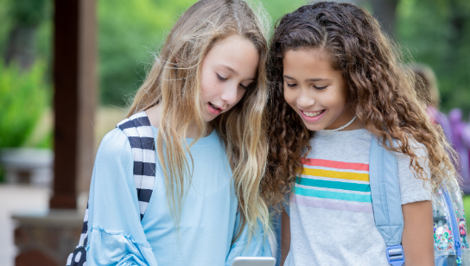
Scenario 12
Abbey has been talking to Rosie about someone she has met online. This person has said that he is the same age as Abbey and is asking her lots of questions about where she lives and when she is able to go out and play. What advice so you think Rosie should give Abbey?

Slide 19
Why don’t people tell a trusted adult when they are worried about a friend?

Slide 20
Why don’t people tell a trusted adult when they are worried about a friend?
They don’t want to get anyone in trouble
They are scared of what might happen
They don’t want their friend to be cross

Slide 21
Remember:
Being a good friend, means keeping your friends safe. Sometimes you need to ask an adult to help you.

Slide 22
Resources:
Childline:
https://www.childline.org.uk/info-advice/friends-relationships-sex/friends/helping-friend/
NSPCC:
https://www.nspcc.org.uk/preventing-abuse/keeping-children-safe/
Peer-on-peer abuse toolkit:
https://www.farrer.co.uk/globalassets/clients-and-sectors/safeguarding/farrer--co-safeguarding-peer-on-peer-abuse-toolkit-2019.pdf

