Slide 1

Keeping Our Friends Safe
Part 1
Notes:
ADOBE STOCK
Certain photographs used in this report have been licensed from Adobe Stock.
These photographs are protected by copyright law. Resale or use of any photos used in this report is prohibited.
Photographs © / Adobe Stock

Slide 2
Who might our friends be?

Slide 3
Who might our friends be?
People where we live
People in school
People online
People in our family
People we go to clubs with

Slide 4
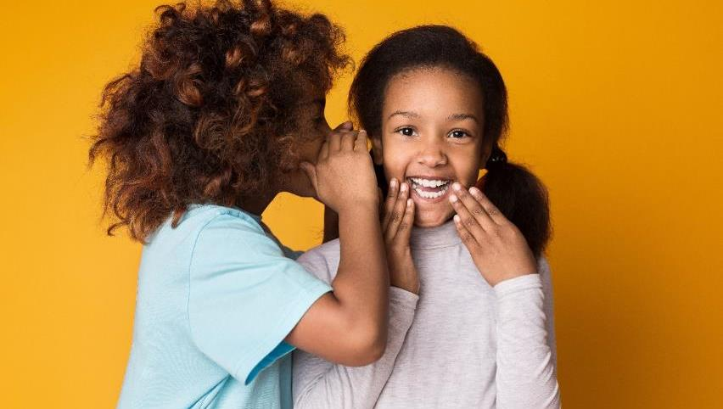
What makes a good friend?
Notes:
Discuss fun, laughter, sharing ideas, sharing thoughts etc. Play clip.

Slide 5
What makes a good friend?
Click here to find
out how to be a
really good friend.
Notes:
Watch film on mental health and how we can help our friends. Could stop after the children chare how they are feeling (last child says ‘confident’) to share own feelings on a post-it.

Slide 6
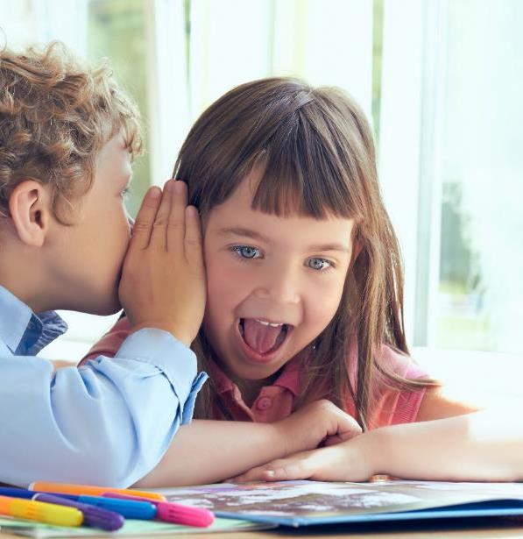
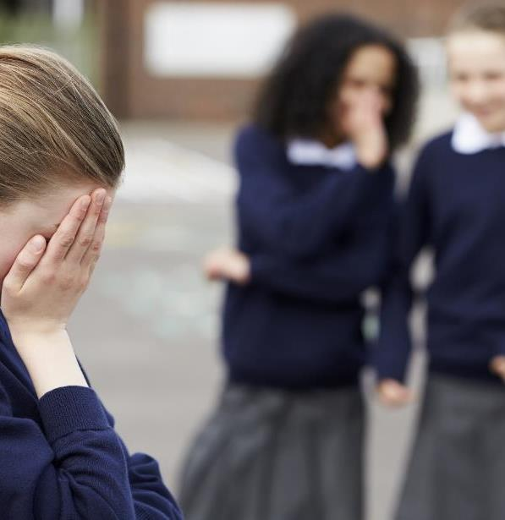
Friends sometimes share secrets.
When can secrets be good? Can they be bad?
Notes:
Discuss.

Slide 7
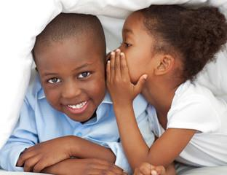


Secrets can be great!
Notes:
Share experiences.

Slide 8
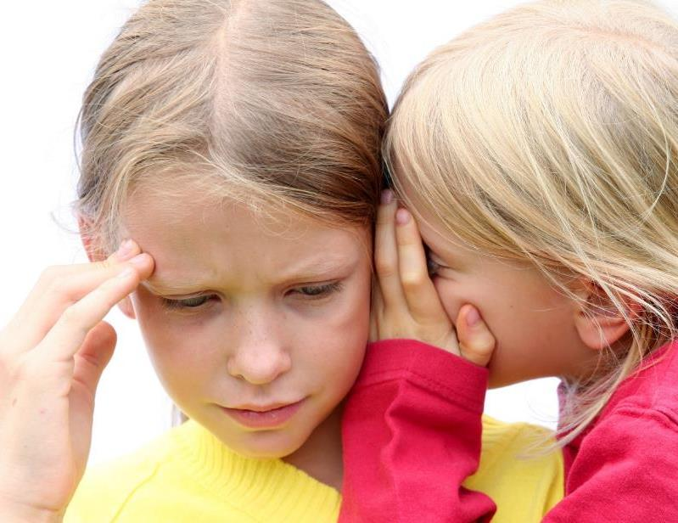
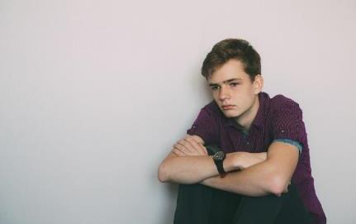
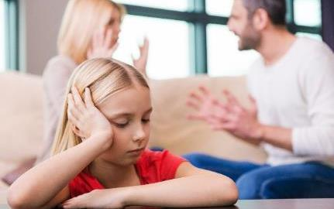
Some secrets need to be shared. But who with?
Notes:
Discuss thoughts/Ideas. Who can they trust? Who could they tell if something was bothering them?

Slide 9
Who should we share things with if we are worried?
Someone we trust
A responsible adult at home
A responsible adult at school
Another responsible adult

Slide 10
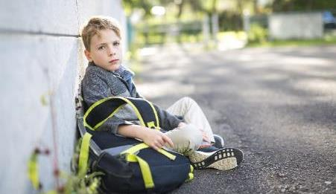
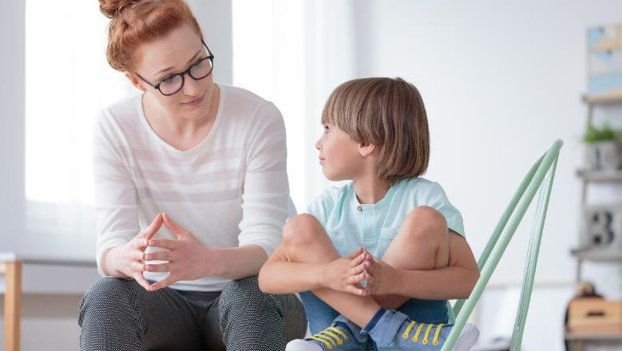
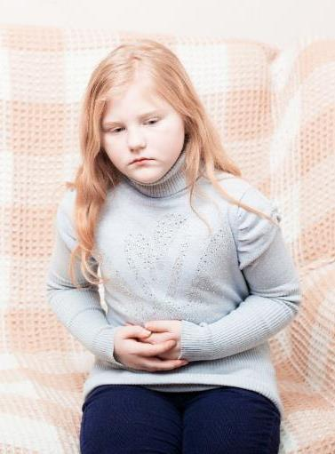

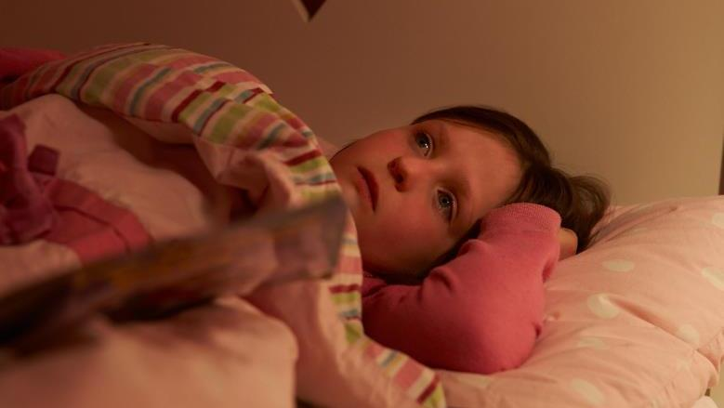
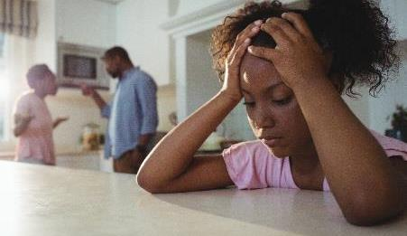
How do you know that it’s a bad secret?
Notes:
Discuss how you feel when you know something isn’t right. Tummy feelings, trouble sleeping, lack of appetite.

Slide 11
Remember:
Being a good friend means helping to keep your friends safe. Sometimes you need to ask an adult to help you.

Slide 12
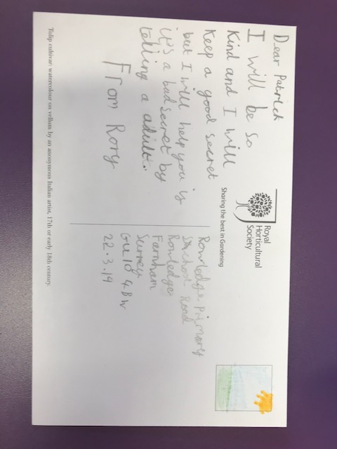
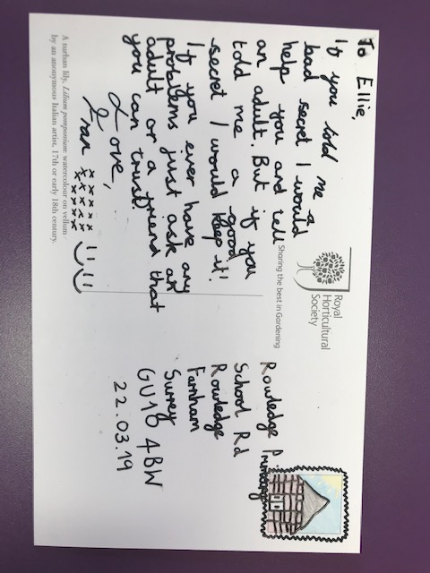
Follow up work – write a postcard to a friend to help them understand.
Notes:
Discuss the key points and ask the children to write to their friend to explain how they would help to keep them safe.

Slide 13
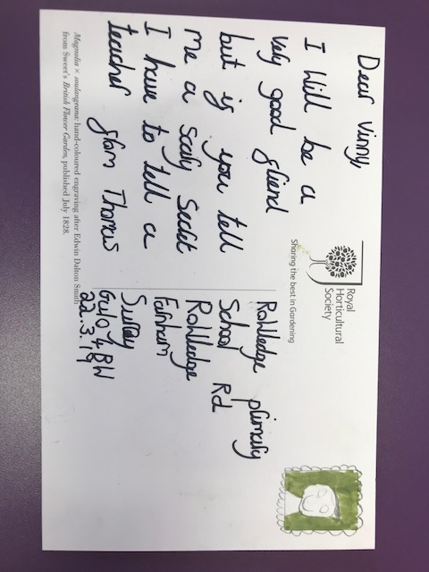

Slide 14
Who else can help?
Childline:
https://www.childline.org.uk/info-advice/friends-relationships-sex/friends/helping-friend/
NSPCC:
https://www.nspcc.org.uk/preventing-abuse/keeping-children-safe/

