Slide 1
Tackling Educational Disadvantage Access, equity and strong foundations
Victoria Flynn
HIAS Inspector/Adviser
victoria.flynn@hants.gov.uk
Notes:
If you know all about the statutory requirements for Pupil Premium funding and

Slide 2
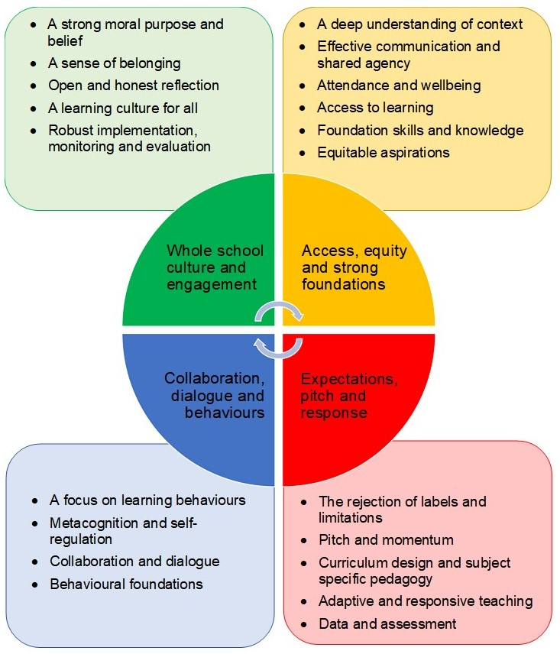
The Four Areas
Whole school culture and engagement
Access, equity and strong foundations
Expectations, pitch and response
Collaboration, dialogue and behaviours

Slide 4
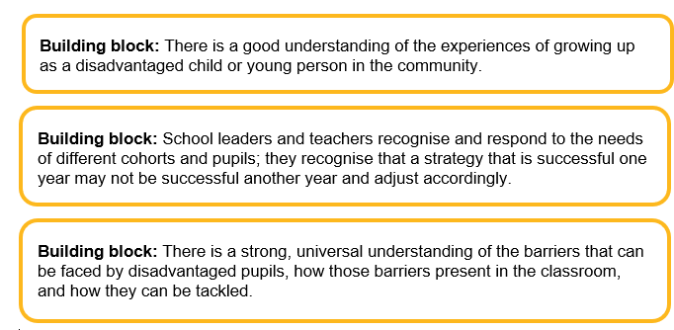
A Deep Understanding of Context
Meeting the needs of school/cohort/pupil specific contexts
Assessment not assumption
Prioritising need

Slide 5
Effective communication and shared agency
Rogers (1959) believed that for a person to “grow”, they need an environment that provides them with genuineness (openness and self-disclosure), acceptance (being seen with unconditional positive regard), and empathy (being listened to and understood).
Saul McLeod, Simply Psychology [blog], Carl Rogers: Founder Of The Humanistic Approach To Psychology, 2023
Engagement with families
Building relationships
Shared Agency
Meaningful participation for all

Slide 6
Attendance and wellbeing
Prevention as well as response/causes not just symptoms
Practical steps to address issues that can arise from poverty
Movement and talk
Relationships

Slide 7
Access to Learning
Access to high quality teaching
Inclusive pedagogy
Effective use of interventions

Slide 8
Foundation Skills and Knowledge
Literacy and numeracy
Oral language/speaking and listening
Cultural capital

Slide 9
Equitable Aspirations
Developing the knowledge, skills and characteristics
Empowering pupils to have choice
Access to a full range of pathways
Living a culture of high aspirations

Slide 10
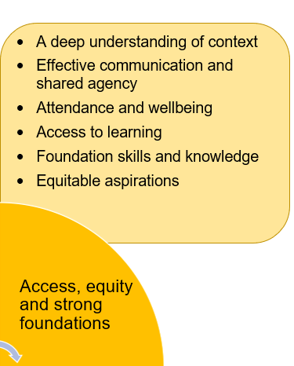
Different contexts
Building relationships and a sense of shared agency with families
Access to the best teaching
Developing foundations skills and knowledge to enable access to the curriculum
High aspirations for all

Slide 11
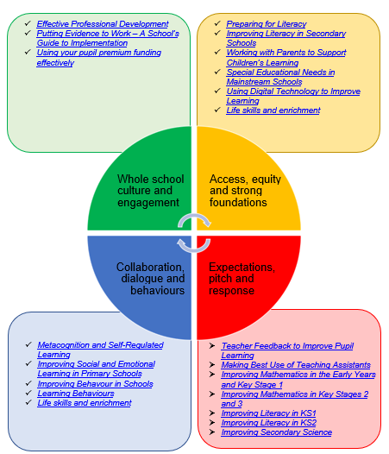
Links to EEF Resources

Slide 12
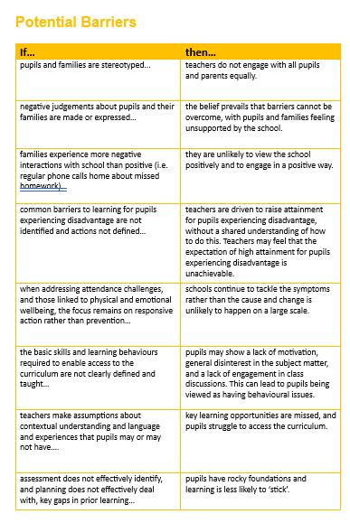
‘Each section sets out a description of best practice and identifies potential pitfalls for schools to avoid.’

Slide 13
Please Get in Touch
I would love to hear your questions, feedback or ideas for content, so please do get in touch:
victoria.flynn@hants.gov.uk

