Slide 1
Tackling Educational Disadvantage Collaboration, dialogue, and behaviours
Victoria Flynn
HIAS Inspector/Adviser
victoria.flynn@hants.gov.uk
Notes:
If you know all about the statutory requirements for Pupil Premium funding and

Slide 2
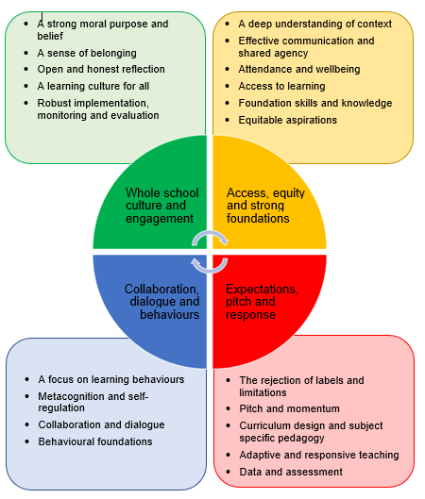
The Four Areas
Whole school culture and engagement
Access, equity and strong foundations
Expectations, pitch and response
Collaboration, dialogue and behaviours

Slide 4
A focus on learning behaviours
Emotional, social and cognitive aspects of learning
Explicitly teaching and modelling learning behaviours with feedback
A model of positive behaviour for learning

Slide 5
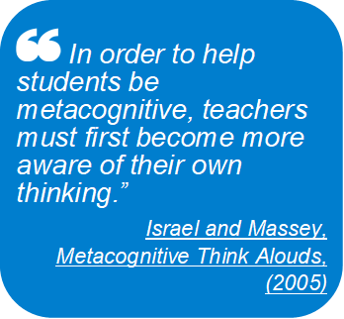
Metacognition and self-regulation
Everyone modelling metacognition and self-regulation
Explicit teaching

Slide 6
Collaboration and dialogue
Explicit teaching of speaking and listening
Teaching pupils to collaborate

Slide 7
Behavioural foundations
A human approach to behaviour – relational rather than punitive
Attachment, trauma, ACEs – empathy, kindness, curiosity
Inclusive cultures
High expectations in the context of scaffolding and support

Slide 8
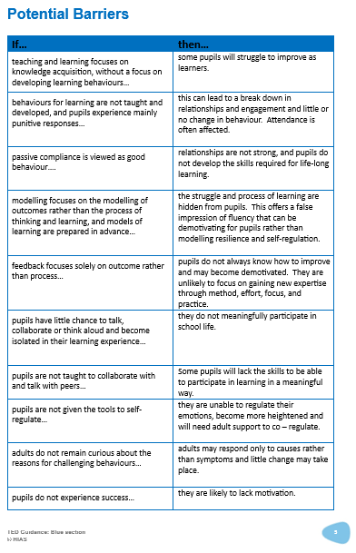
‘Each section sets out a description of best practice and identifies potential pitfalls for schools to avoid.’

Slide 9
Please Get in Touch
I would love to hear your questions, feedback or ideas for content, so please do get in touch:
victoria.flynn@hants.gov.uk

