Slide 1
Tackling Educational Disadvantage Whole School Culture and Engagement
Victoria Flynn
HIAS Inspector/Adviser
Victoria.Flynn@hants.gov.uk
Notes:
If you know all about the statutory requirements for Pupil Premium funding and

Slide 2
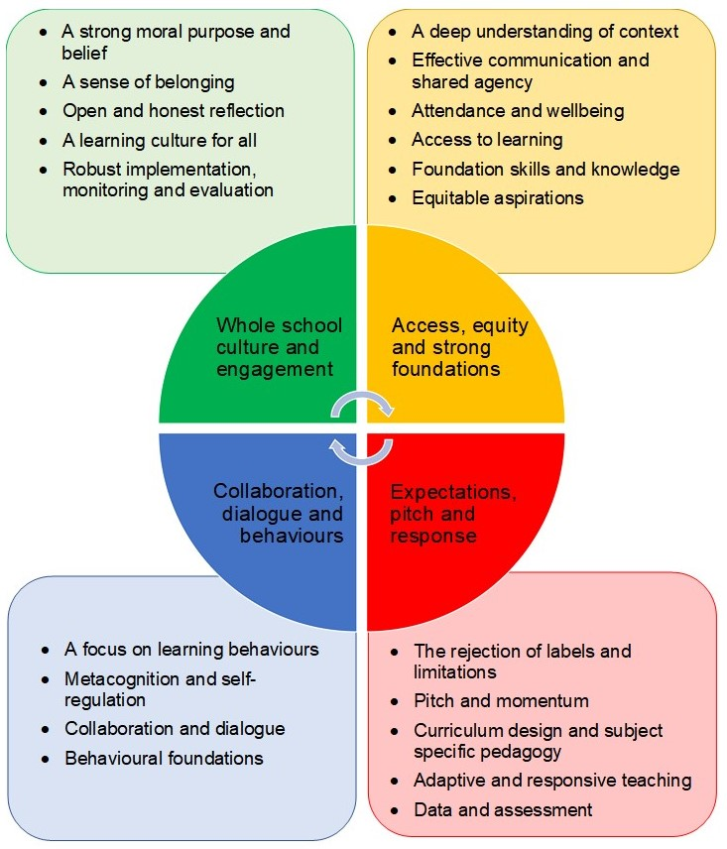
The Four Areas
Whole school culture and engagement
Access, equity and strong foundations
Expectations, pitch and response
Collaboration, dialogue and behaviours

Slide 3
A Strong Moral Purpose and Belief
Belief in pupils
Valuing pupils
Accountability to the pupils
Strengths-based approach
Belief that schools can make a difference

Slide 4
A Sense of belonging
For pupils and for staff
Positive, trusting, reciprocal relationships
Hearing the voices of all
Engagement in wider school life
Meaningful participation

Slide 6
A Sense of belonging
For pupils and for staff
Positive, trusting, reciprocal relationships
Hearing the voices of all
Engagement in wider school life
Meaningful participation

Slide 7
Open and honest reflection
Honest and robust self-evaluation with pupil premium strategy reflecting reality
Listening to the views of all stakeholders
Seeking information, advice and guidance
A safe learning culture

Slide 8
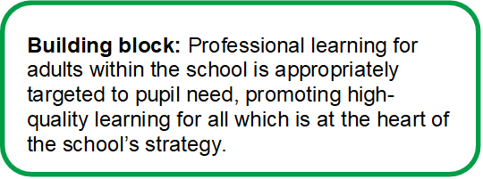
A Learning Culture for All
Using the lens of pupils most vulnerable to underachievement
Effective continuing professional development (CPD)
The use of research
A learning community
Collective efficacy
A school staff that believes it can collectively accomplish great things is vital for the health of a school and if they believe they can make a positive difference then they very likely will.”
Hattie, Visible Learning

Slide 9
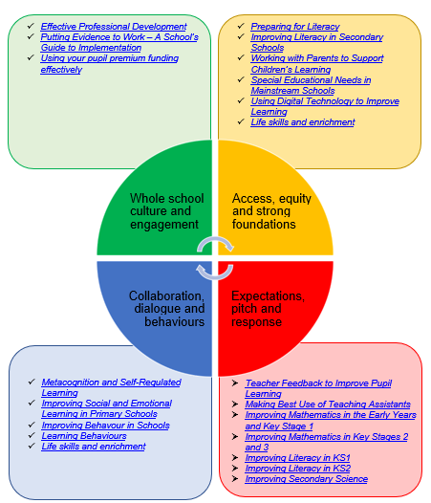
Links to EEF Resources

Slide 10
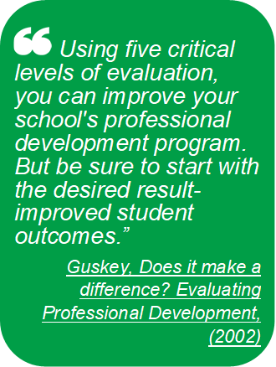
Robust implementation, monitoring and evaluation
Pupil premium spending – leaders and governors
Rationale
Diagnostic assessment
Success criteria and impact measures
Quality of implementation
Ongoing monitoring and evaluation
Evaluating impact (not activity)
Response

Slide 13
Everyone playing their part
The importance of relationships
Honest evaluation with clear success criteria
Effective professional development
The impact on pupils’ learning

Slide 14
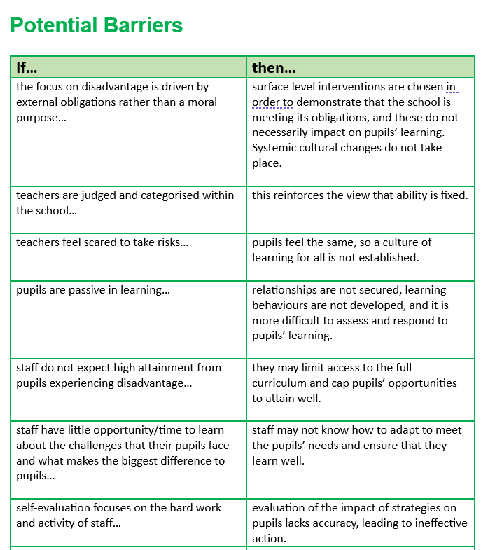
‘Each section sets out a description of best practice and identifies potential pitfalls for schools to avoid.’

Slide 16
Please Get in Touch
I would love to hear your questions, feedback or ideas for content, so please do get in touch:
Victoria.Flynn@hants.gov.uk

