Slide 1
Tackling educational disadvantage (TED) Introduction to guidance materials
Victoria Flynn, Inspector/Adviser for Tackling educational disadvantage

Slide 2
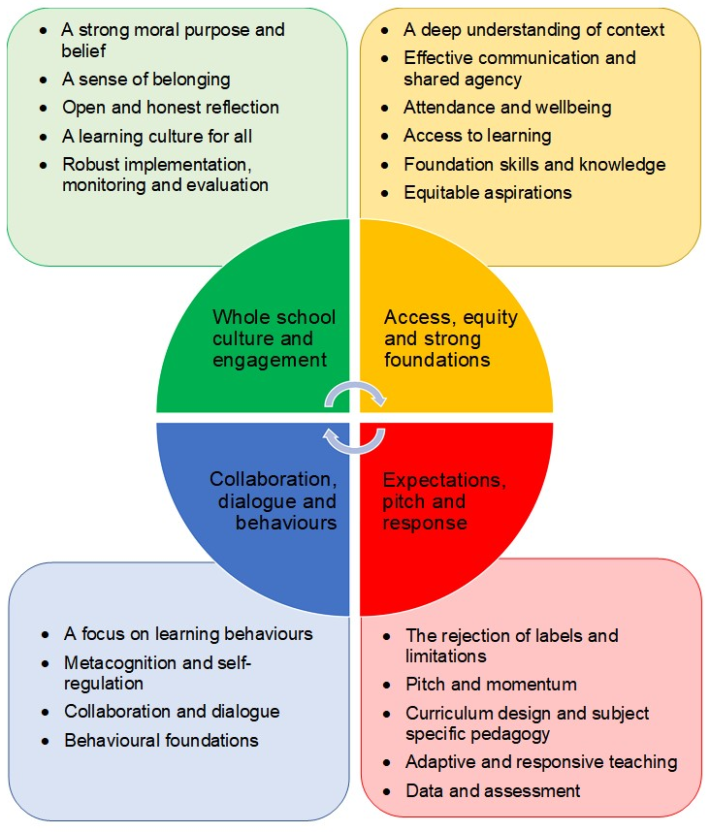
Introduction
TED Moodle page
Supporting networks and bespoke work
How the guidance works
Building blocks
A word of caution
The four core sections
Bibliography.

Slide 4
Please get in touch
We would love to hear your questions, feedback or ideas for content, so please do get in touch.
Email: victoria.flynn@hants.gov.uk.
@HiasInclusion

