Slide 1
Yes to Autism
David Burns

Slide 2
Morning break
10:30-11:00

Slide 3
Workshop Session 1 11:00-12:15
Workshop 1A | An introduction to Dyslexia Lisa Karalius HIAS Inspector/Adviser for English | Monarch Suite
Workshop 1B | Neurodiversity and Mental Health Niki Wilson – Headteacher Rachel Maddocks Special School | Hampshire Suite
Workshop 1C | Making Sense of Autism Mehal Shah – Co-Headteacher Henry Tyndale School | Emperor Suite

Slide 4
SENCo Updates
Sarah Kiel

Slide 5
An introduction to Dyslexia
Lisa Karalius

Slide 6
Making Sense of Autism
Mehal Shah

Slide 7
Neurodiversity and Mental Health
Niki Wilson

Slide 8
Lunch
12:30-13:15

Slide 9
Neurodiversity in Education
Suzy Rowland

Slide 10
Workshop Session 2 14:30-15:45
Workshop 2A | An introduction to Dyslexia Lisa Karalius HIAS Inspector/Adviser for English | Monarch Suite
Workshop 2B | Neurodiversity and Mental Health Niki Wilson – Headteacher Rachel Maddocks Special School | Emperor Suite
Workshop 2C | Making Sense of Autism Mehal Shah – Co-Headteacher Henry Tyndale School | Hampshire Suite

Slide 11
SEN Services Update
Jane Howarth

Slide 12
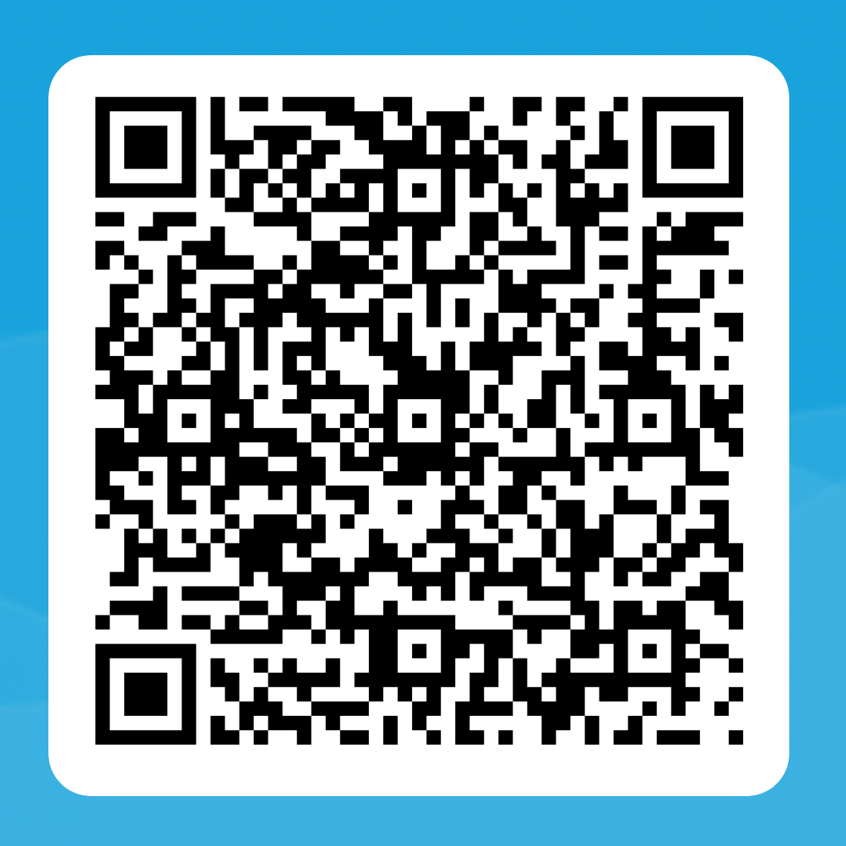
Your feedback matters
Please take a few minutes to complete our online conference evaluation form.
Thank you!

