Slide 1
How to check/update your correspondence email address
Go to the HCC shared services page - https://extra.hants.gov.uk/sharedservices. You will need your personnel number if you have not yet registered to access to ESS Lite
Click the ESS Lite tile & select “My Information”
Ensure that both the Personal Email and Correspondence Email boxes are completed. Please use your school/institution email address
No email address in the Correspondence Email = no booking confirmations, joining information or course notifications

Slide 2
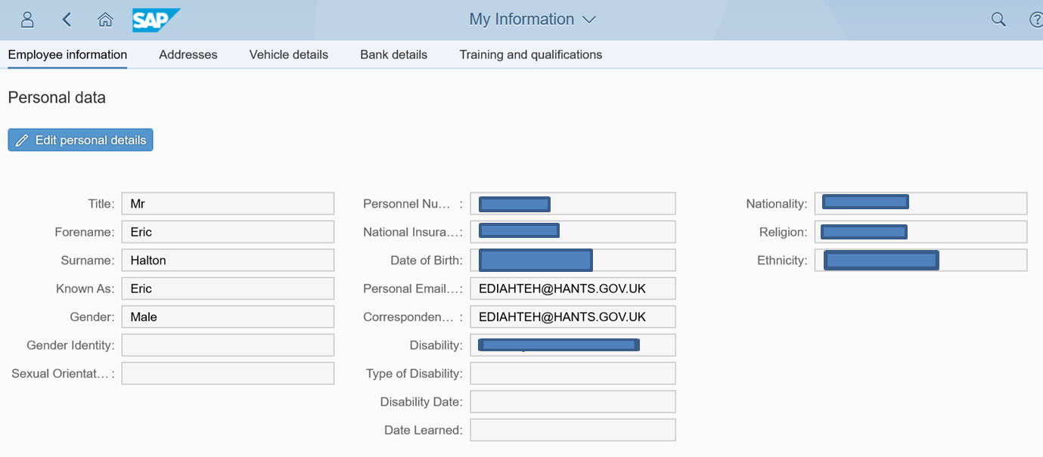
Important communications from the Learning Zone
THIS IS THE ONE THAT MATTERS TO THE LEARNING ZONE

