Slide 1
Early Career Teacher Induction Tutor and Coordinator Briefing
Kila Barber
Leadership and Learning Partner - HIAS
Visiting Fellow – My Ambition

Slide 2
Aims of the Session
1. Overview of Hampshire Offer
Assure
Align
Advance
2. Statutory Requirements
Appropriate Body
Early Career Framework (ECF)
3. Roles and responsibilities
Early Career Teacher
Mentors
Leads/ Coordinators
4. Navigation of My Ambition/Steplab
5. Upcoming events/communication
6. Further support

Slide 3
Overview of Hampshire Offer

Slide 4
Statutory Requirements
Appropriate Body (Hampshire Assure)
DfE requirement that Early Career Teachers are able to meet the Teachers Standards
Formal assessments
Ensure that the ECT is receiving the appropriate support from the school
ECTmanager provides the platform – you must complete formal reviews terms 1,2,4,5 and full assessments terms 3 & 6
All other paperwork is for school records only
Early Career Framework (ECF)
Programme of CPD to develop the ECT to be the best they can be
Mentor provides weekly/fortnightly coaching
Self -study
MyAmbition is the training organisation that Hampshire has partnered with
No Assessment – two year developmental programme, to support and retain ECTs
Notes:
Concern over duplication of material
2 different purposes
ECTmanager - is the platform Hampshire use to link with DfE to record progress towards meeting the teacher standards ( modified NQTmanager)
There must be an evidence trail and formal judgemental assessments against the teaching standards
There are they on track’ tickbox assessment at the end of each term 1,2,4,5 and the two more formal full written assessments in term 3 and 6 (which is the two you’re referring to) – may be worth being clear on this on the slide
My Ambition uses the platform Steplab to provided a very comprehensive programme of support.
There is no expectation to keep paperwork, however the stepped programme is very comprehensive and some schools have decided not to use all the paperwork in ECTmanager and to use Steplab as their evidence base.
However I would strongly suggest that as part of the weekly mentor/ ECT meeting a weekly record of progress towards the teacher standards is kept
Give clarity to who should be filling in the forms and what evidence should be kept.

Slide 5
Appropriate Body - ECTmanager
Notes:
As the stepped programme is very comprehensive, some schools have decided not to use all the paperwork in ECTmanager and to use Steplab as their evidence base.
However I would strongly suggest that as part of the weekly mentor/ ECT meeting a weekly record of progress towards the teacher standards is kept alongside the Teachers Standards record of evidence tracker. This will be essential evidence for the Appropriate Body aspect especially if your ECT is not making expected progress. School needs to evidence that they have put in sufficient support.

Slide 6
Roles and responsibilities – MyAmbition/Steplab
Early Career Teacher
Weekly Self Study units on Steplab
Primer, quiz, training video, reflection task (½ hour a week)
Action step to practice in the classroom
Mentors
Weekly observation of the ECT (max 15 minutes)
Preparation of coaching session
Coaching session based on identified step (½ hour)
Leads/Coordinators
Ensure that ECT has designated 10% study time in Y1 (5% in Y2)
Ensure that Mentor is observing and coaching the ECT on a weekly basis
Keep overview of ECT progress
Notes:
Explain All Events are found My Ambition for mentors and ECTs – no training for Leads – so this is why we have put this in – would more be useful?
Steplab is the small step programme for ECTs and mentors
3 terms: behaviour, instruction and subject
Explain the expectations
No new material in Y2
Not a race
But time must be allocated for ECT/ mentors to work together
Designed to be comprehensive – but has been overwhelming for many.

Slide 7
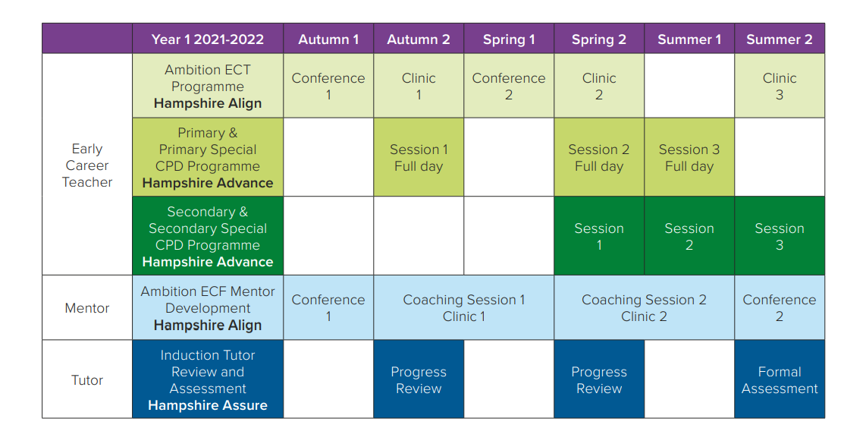
Upcoming events/communication
Leads/coordinators – receive an update of upcoming events to be passed to the mentor/coach
Each mentor/ECT can track their invites through the Events window on MyAmbition
An email is also sent from ECT.Align@hants.gov.uk
Lead
Notes:
Talk through each role and responsibility and event on the timeline
Lines of communication – ECT.Align@hants.gov.uk

Slide 8
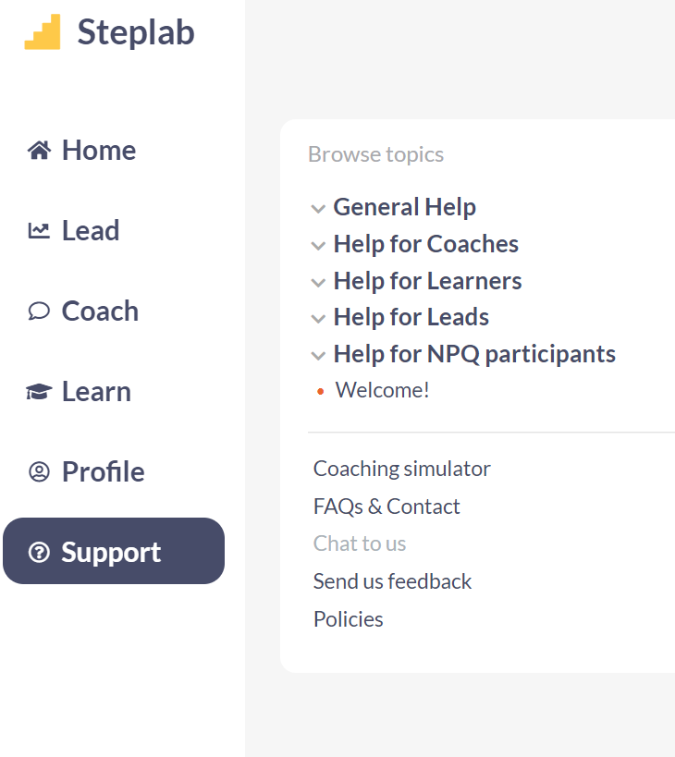
Navigation of MyAmbition/Steplab
Notes:
Link to Leads training Knowledge Base | Steplab – what you need to do
Nudge and praise buttons
Link to mentors/ coaches – what they need to do observing and the coaching
Link to ECT/ learners – using learn and study for ECT first years

Slide 9
Further support
If you have any questions about:
the Hampshire Align programme
Please use ECT.Align@hants.gov.uk
For technical support on Steplab/MyAmbition
ectsupport@ambition.org.uk
Notes:
Link to Leads training Knowledge Base | Steplab – what you need to do
Link to mentors/ coaches – what they need to do observing and the coaching
Link to ECT/ learners – using learn and study for ECT first years

